Slide 1
Boosting Single Page Application Security with Backend for Frontend Pattern and YARP
Phong Nguyen

Slide 2
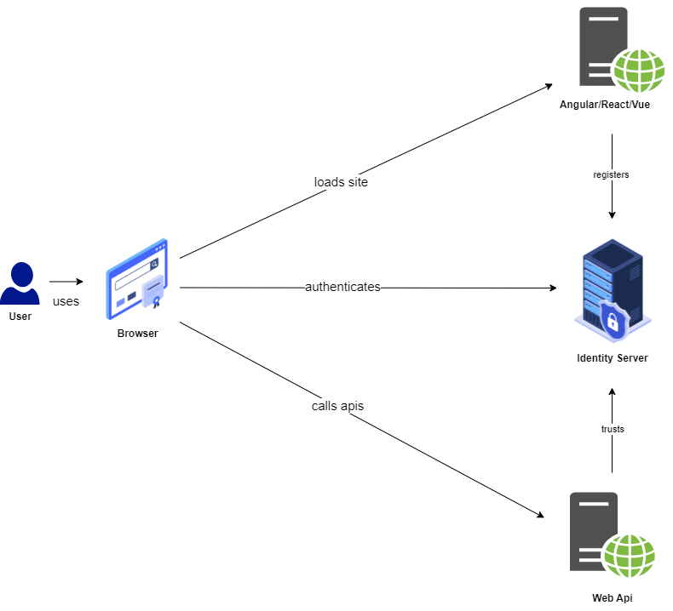
Common SPA Context Diagram

Slide 3
Common SPA Characteristics
Static Assets (HTML, JavaScript, CSS, …).
Client-Side Rendering (CSR).
Token-Based Authentication.
Anti Cross-Site Request Forgery (CSRF) if Cookie is not used, otherwise, it depends.
Still be vulnerable to Cross-Site Scripting (XSS).

Slide 4
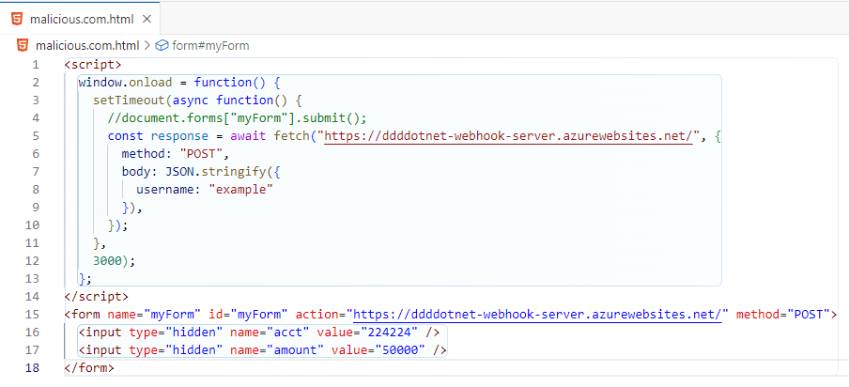
CSRF Recall
https://malicious.com

Slide 5
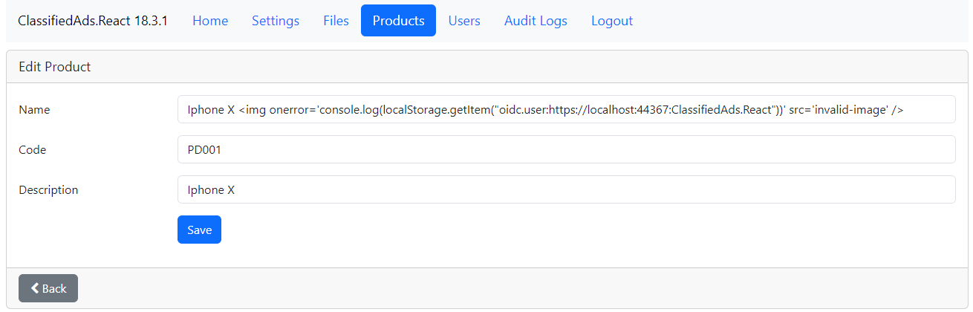
XSS Recall (1/3)

Slide 6
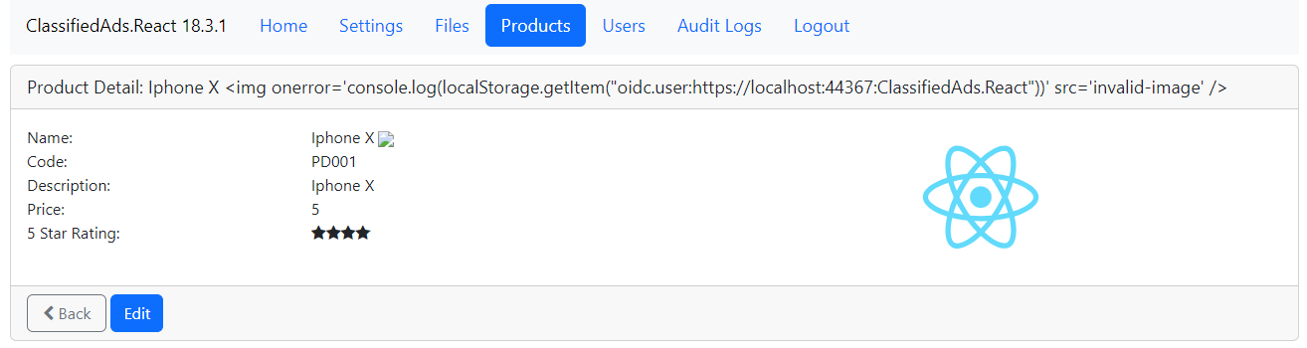
XSS Recall (2/3)

Slide 7
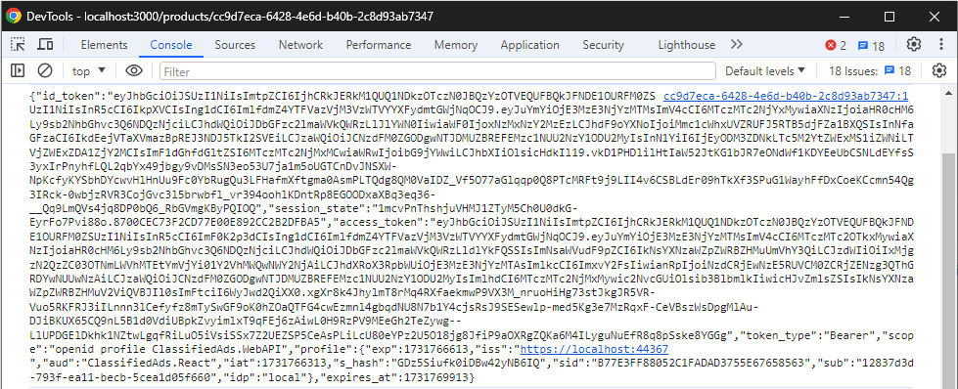
XSS Recall (3/3)

Slide 8
Common Problems with Tokens
Fixed Lifetime.
Immutable.
Difficult to handle Sliding Expiration.

Slide 9
Workarounds
Increase Token Lifetime.
Refresh Token.

Slide 10
Problems with the Workarounds
Because token is stored on the client side, in the event of token leaking (especially refresh token), it can be a disaster.

Slide 11
How to Protect Tokens?
Do not use token for session management.
Do not store token(s) on client side.

Slide 12
Backend for Frontend Pattern

Slide 13
What is the Backend for Frontend (BFF) Pattern?
Separate backend services are created specifically for different frontend applications, such as web, mobile, or other clients.
Instead of a single backend trying to accommodate all types of clients, BFF allows each client to have a custom backend that caters to its specific needs.

Slide 14
Benefits of BFF
Optimizes performance by minimizing data processing and handling on the frontend, ensuring that each client only receives the relevant data and logic.
Simplifies the frontend logic and improves user experience by reducing the burden of handling complex API responses.

Slide 15
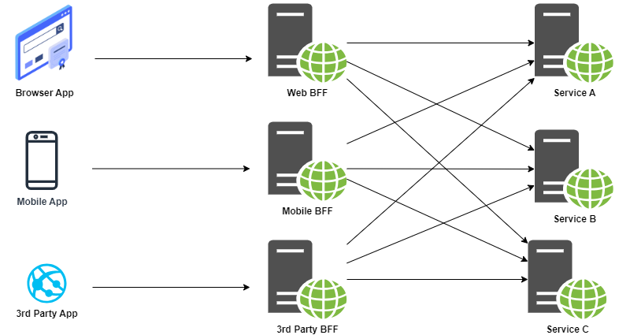
Common BFF Usage

Slide 16
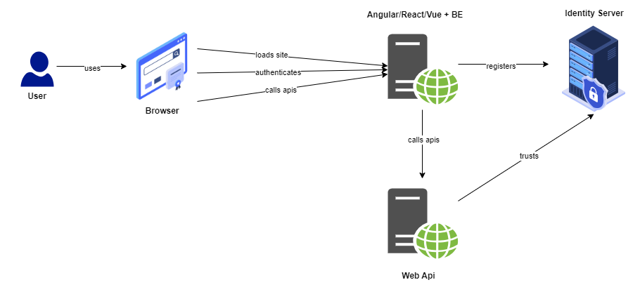
BFF for Session and Token Management

Slide 17
BFF for Session and Token Management
Back to using Cookie for Authentication and Session Management.
Tokens are stored on server site.
Vulnerable to Cross-Site Request Forgery (CSRF).
Still be vulnerable to Cross-Site Scripting (XSS) even Cookie is set HttpOnly.
Complexity in API interactions.

Slide 18
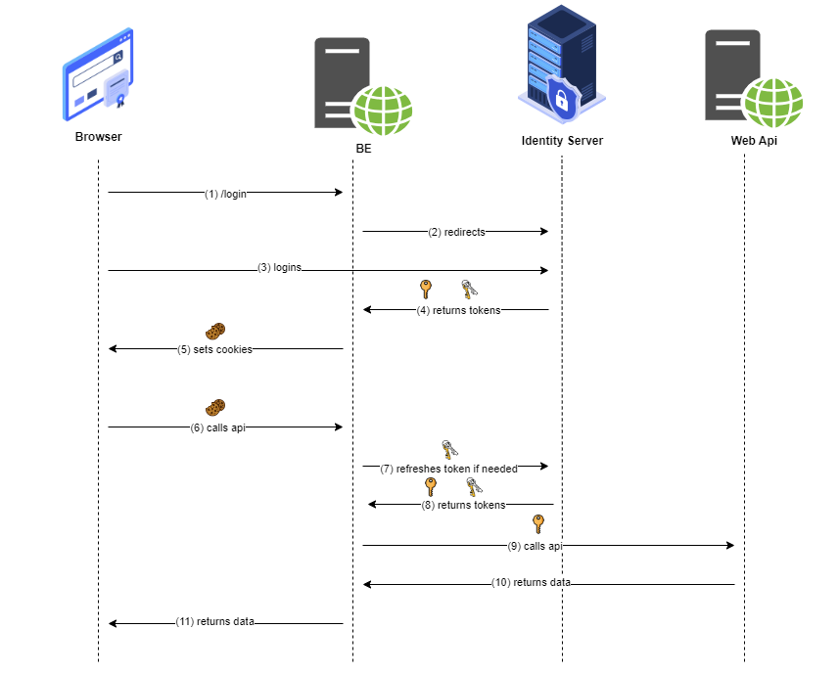
The BFF Flow

Slide 19
Simplifying API Interactions with YARP

Slide 20
What is YARP?
YARP stands for Yet Another Reverse Proxy.
An opensource .Net library to help create reverse proxy servers that are high-performance, production-ready, and highly customizable.

Slide 21
Common Use Cases of YARP
API Gateway.
Load Balancer.
Traffic Routing.
Reverse Proxy for Security.

Slide 22
Demo

Slide 23
Half BFF

Slide 24
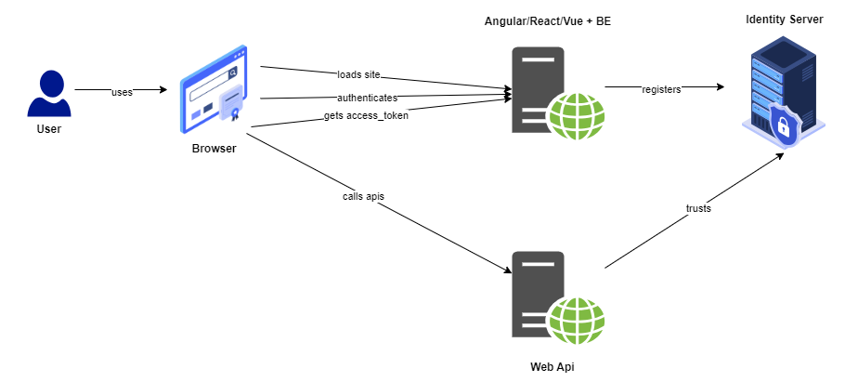
Half BFF

Slide 25
Q & A

Slide 26
Thank you

Slide 27

Get .NET 9
Download .NET 9 aka.ms/get-dotnet-9

Slide 28
Source Code Demo
https://github.com/phongnguyend/Practical.CleanArchitecture

